Slide 1
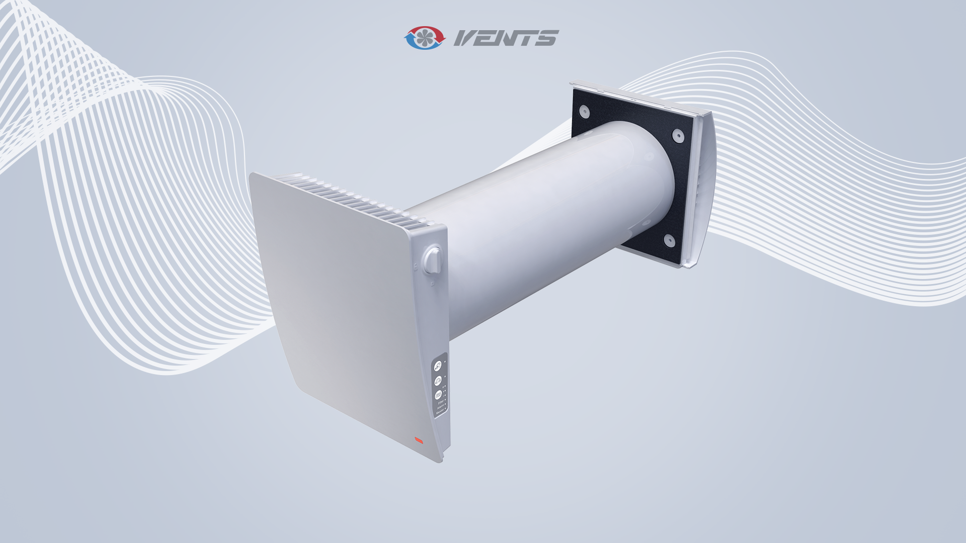
Vents TwinFresh Style
Notes:
I would like to begin with the brand-new Vents TwinFresh Style unit.
This is a residential, push-pull, single room, ventilation unit with heat recovery.
Let me skip general information about what push-pull means, and how heat recovery works.
The TwinFresh Style unit is the most advanced unit in the Vents assortment of push-pull units.
This unit became possible thanks to active support and feedback of our clients and customers.
Together, we have collected a lot of experience, during a years of selling, of our previous TwinFresh modification.

Slide 2
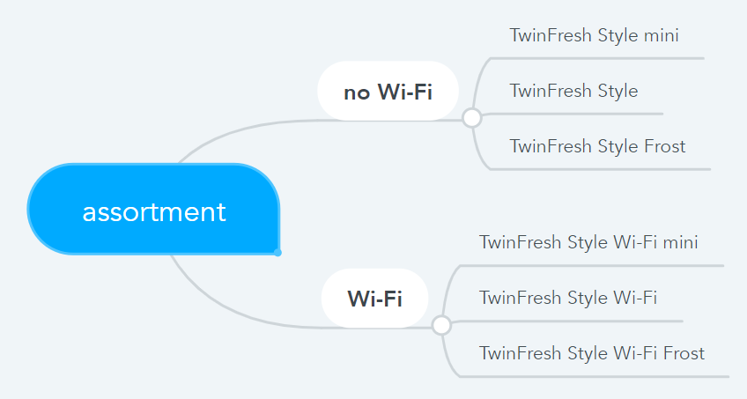
Assortment
Vents TwinFresh Style
Notes:
For better understanding of the TwinFresh Style assortment, I have prepared this diagram.
The assortment can be divided into two halves, because there are two control systems available:
Basic one, without Wi-Fi. In this case, the units must be connected with signal wire, and have basic functions;
And advanced, with Wi-Fi. In this case, the units can be connected by Wi-Fi, and mobile application provides rich functionality.
In both cases, three units are available:
Small one, with 100 mm duct. It is called TwinFresh Style mini;
Regular, and the most popular one, with 160 mm duct. It is called TwinFresh Style;
And the third modification for cold climate. It is called TwinFresh Style Frost.

Slide 3

Characteristics
Vents TwinFresh Style
Name | Diam., mm | Air flow, m3/h | Min. temp., ^{O}C | Heat recovery efficiency, % | Power, W
TwinFresh Style mini | 100 | 8 / 16 / 24 | -15 | DIBT 75 expected | 1,8 / 3 / 4,4
TwinFresh Style | 160 | 15 / 30 / 50 | -20 | 78…90 (DIBT 80) | 2 / 3 / 5,5
TwinFresh Style Frost | 160 | 15 / 30 / 50 | -30 | 78…90 (DIBT 80) | 2 / 3 / 5,5
*Coming soon. Already tested in Stuttgart
Notes:
Let’s take a closer look at three basic units.
1-st: TwinFresh Style mini with 100 mm duct.
The maximum airflow of this unit is 24 m3/h in ventilation mode. Meaning, in heat recovery mode, this should be divided by half.
Minimum operation temperature is -15.
Next month this unit will be sent to Stuttgart for precise testing at independent third party laboratory.
We expect the TwinFresh Style to show about 75 % of heat recovery efficiency.
2-nd: The TwinFresh Style unit has a 160 mm duct.
The maximum airflow of this unit is 50 m3/h.
With this modification we have significantly improved airflow sensitivity up to S3 class according to EN 13141-8. This is the best result among all our push-pull units.
For your information, the airflow sensitivity parameter characterizes, how wind pressure influence operation of the ventilation unit.
Minimum operation temperature is -20 ^{O}C.
The unit was already tested in Stuttgart, and we can provide you with a test report on you demand.
The TwinFresh Style did show 80 % of heat recovery efficiency according to DIBT, and from 78 to 90 % according to EN 13141-8.
Soon, we will receive the DIBT certificate for this unit based on the Stuttgart test report.
3-rd one: The TwinFresh Style Frost unit has a 160 mm duct for cold climate.
We have just added a heater into the outer hood, that heats up air a little bit when it is extremely cold outdoor.
This solution guarantees operation of the unit down to -35 ^{O}C.
All the rest characteristics remain the same as regular TwinFresh Style unit.

Slide 4

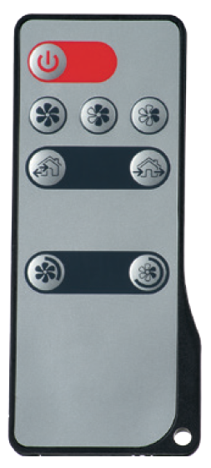
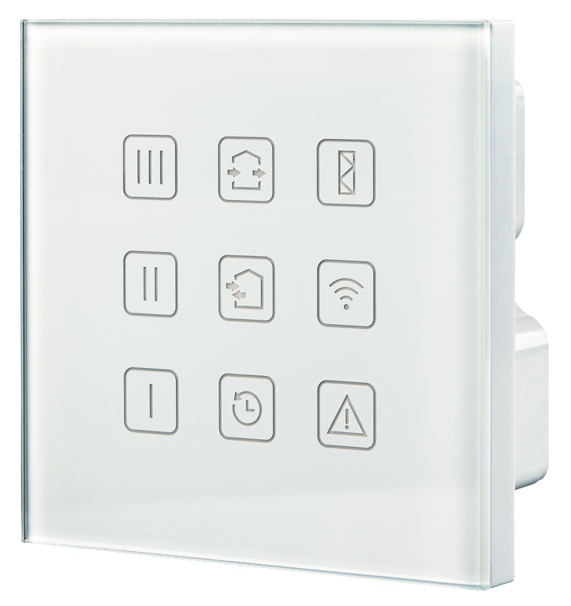
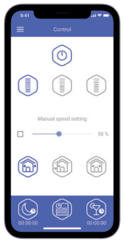
Functions
Vents TwinFresh Style
 | Sensor buttons | IR remote control | Filter maintenance indication | Timer | Humidity sensor | Week schedule | Wall mounted panel | Smartphone app
No Wi-Fi | + | + | + | + | +
Wi-Fi | + | + | + | + | + | + | + | +
Notes:
As I have already mentioned, the TwinFresh Style unit can be equipped with two control systems: with or without Wi-Fi.
The basic control system without Wi-Fi has following functions:
It can be controlled with sensor buttons on the casing of the unit or with a Infra Red remote control;
There is a filter maintenance indication and alarm indication in case of failure;
User can activate “night” timer, that will reduce speed to the lowest level for 8 hours,
as we as “party” timer, that will increase speed to the highest level for 4 hours;
There is a built-in humidity sensor, or external sensor can be connected by wire. This can be for example CO2, VOC or humidity sensor;
In order to unite many units into one ventilation system, they must be connected with signal wire.
The advanced control system is equipped with Wi-Fi. It has all the mentioned above functions, plus additional ones:
There is no need to install signal wire. All the units can be synchronized using Wi-Fi;
Additional interface is available, like wireless wall mounted control panel, and smartphone application;
The smartphone makes it possible to control ventilation from all around the globe;
Also, the user can adjust week schedule.

Slide 5
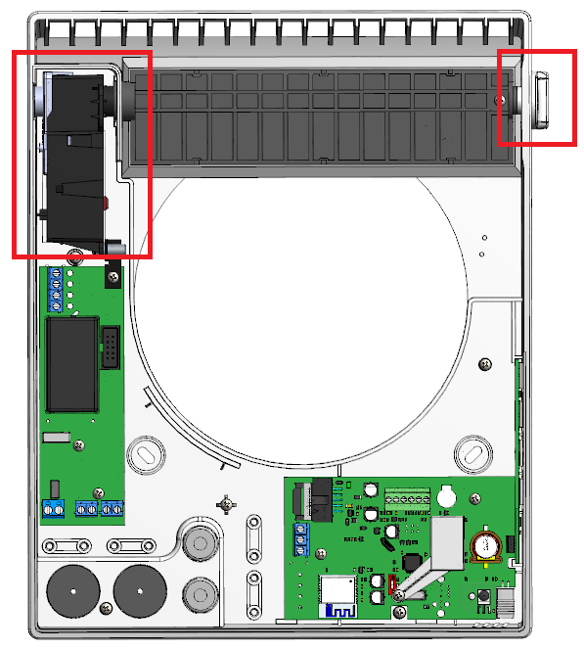
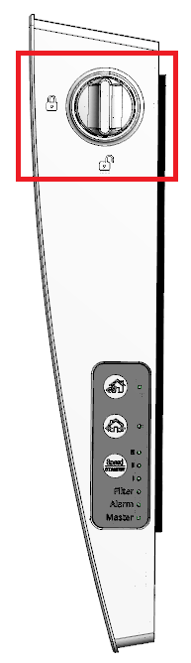
Air damper
Vents TwinFresh Style
Air tightness class D1 (EN 13141-8)
Automatic actuator consumes electricity only while opening and closing. This reduces total power consumption and improves SFP of the unit.
The unit can be supplied with or without an automatic actuator.
The unit is equipped with a knob for manual opening and closing of the air shutter.
Notes:
The new construction of air shitter guarantee maximum air tightness class D1 (EN 13141-8).
Automatic actuator consumes electricity only while opening and closing. This reduces total power consumption and improves SFP of the unit.
The unit can be supplied with or without an automatic actuator.
At the right of the unit you can see a knob for manual opening and closing of the air shutter.
As you can see, the grill is located at the top of the unit. This directs supply air stream upwards, which is beneficial, because user will not feel draughts or cool air spreading along the floor.

Slide 6
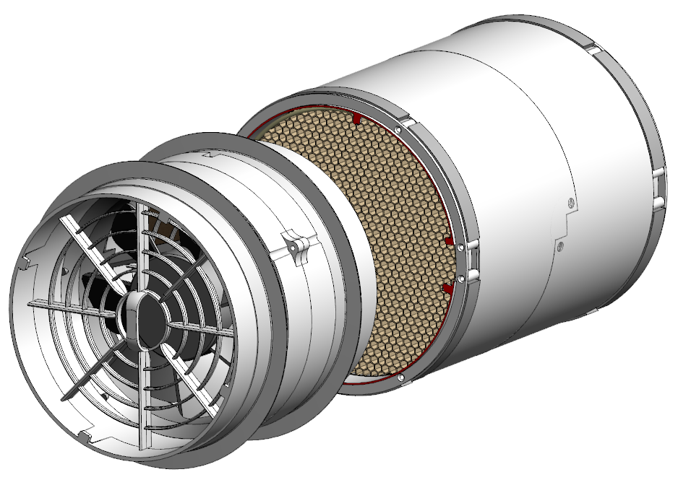
New fan and heat regeneration modules
Vents TwinFresh Style
Improved airflow sensitivity up to S3 (EN 13141-8)
Low 1700 RPM @ 50 m3/h result in reduced noise.
The fan module is separated from a heat regeneration module. This gives following benefits:
Even distribution of air flow across the cross section of the heat regenerator improves heat recovery efficiency;
Easy maintenance and replacement.
Notes:
New fan and heat regeneration modules were developed for the TwinFresh Style unit.
Significant home work was done with the new fan module.
We have achieved S3 class of airflow sensitivity according to EN 13141-8.
Also, we have managed to reach 50 m3/h of airflow at 1700 RPMs only, which results in low noise.
As you can see, the fan module is separated from a heat regeneration module. This gives following benefits:
Even distribution of air flow across the cross section of the heat regenerator improves heat recovery efficiency;
Easy maintenance and replacement.

